Slide 1
Macedonia
Hitchhikers Guide to the Past
By Jim Brendlinger

Slide 2
Geography
Macedonia was located north of greece
Because of this location there were no hard to pass natural land borders
This allowed Macedonia to easily expand
Macedonia was near to the Mediterranean and at the same time in tune with the rest of Europe.

Slide 3
Geography
Macedonia however expanded slowly.
During expansion of Macedonia, there was only quarrel over land for political purposes.
Macedon’s geography gave it a strategic advantage to expand…

Slide 4
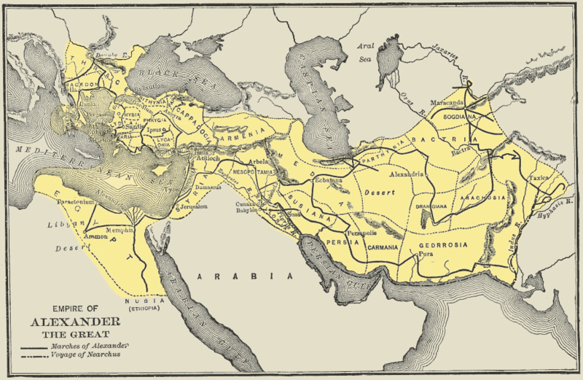
Alexander’s Empire, and routes of expansion

Slide 5
Science & Techonology
Macedonia’s army was to be revered due to its endeavors on the battle field
Many weapons and the flexibility they offered grew famous due to the tactical advantage they provided.
Long pikes (held with two hands and contained to bars to be slid together for battle)
The Sarissa was a double pointed heavy spear that was also introduced…

Slide 6
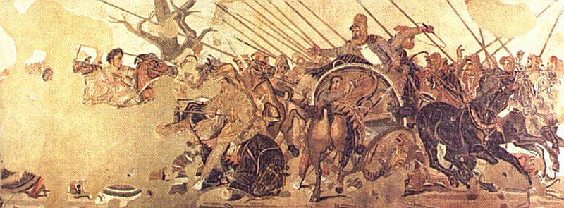
Science & Technology
Heavy armor was also developed and applied in Macedon.
Among heavy equipment were optimally built shields. They often served in the a phalanx.

Slide 7
Science & Technology …
The Macedonians also had their own calendar which is simply named the Ancient Macedonian Calendar
It contained 12 months but later grew to complicated since a month was added to stay in order with the seasons.

